Slide 1
V
VERITAS BANK
Analyzing Customer Churn
and Retention Patterns
A Power BI Analysis of a UK-Based Multinational Retail Bank
United Kingdom • Germany • France
Individual Project • Customer Churn Analysis Using Power BI Prepared by: Emmanuel Sey Williams |

Slide 2
Company Overview
Who is Veritas Bank?
Veritas Bank is a UK-headquartered retail bank established in the 1990s, with major operations across Germany and France. Over the past two decades the bank has grown its customer base to over 3 million, focusing on core retail offerings such as savings accounts, personal loans, debit/credit card services, and online banking.
Headquartered in London, Veritas Bank is known for its technology-driven approach, with strong online banking capabilities and regional service hubs across continental Europe — tailoring services to local regulatory and customer behaviour requirements in each of its three core markets.
1990s
1
Year Established
3M+
3M+
Customers Served
3
3
Core Markets: UK, Germany, France
L
London
Global Headquarters
Veritas Bank | Customer Churn & Retention Analysis
2

Slide 3
The Business Challenge
Veritas Bank is facing increased customer churn, and retention has become a growing challenge.
1
Intense Competition
2
Declining Engagement
Growing pressure from neobanks and fintech startups drawing customers away with faster, cheaper digital experiences.
A perceived decrease in customer engagement in the Germany and France markets specifically.
3
No Targeted Retention
4
No Real-Time Monitoring
Lack of retention strategies built on real behavioural insight, leaving at-risk customers untouched.
Absence of real-time churn monitoring and customer segmentation makes it hard to respond proactively.
Veritas Bank | Customer Churn & Retention Analysis
3

Slide 4
Data & Approach
DATASET — KEY FIELDS
CustomerId / LastName — Unique customer identifier
TECHNOLOGY STACK
CreditScore — Customer creditworthiness
▪ Microsoft Power BI — dashboard development ▪ Power Query — data cleaning & transformation ▪ DAX Measures — churn rate, segmentation logic ▪ Data Visualisation Best Practices
Country / Gender / Age — Core demographics
Tenure — Years as a bank customer
Balance — Account balance (£)
Products — Number of products held
CreditCard / ActiveMember — Product & engagement flags
PROJECT PHASES
01
Data Importation & Setup
Exited — Churn indicator (target variable)
Import data, run data quality checks
02
Transformation & Feature Engineering
Derived columns, churn analysis views
03
Modelling & Dashboard Development
DAX measures, demographic & churn dashboards
Veritas Bank | Customer Churn & Retention Analysis
5

Slide 5
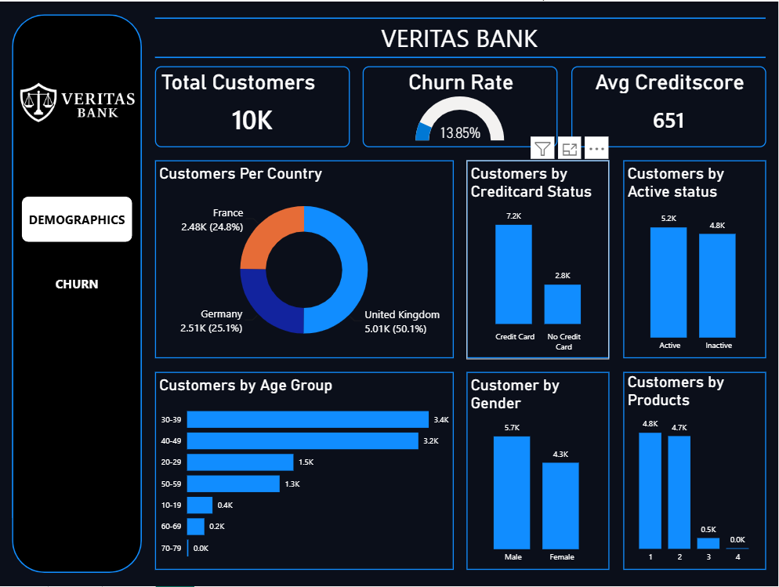
Dashboard — Customer Demographics
Page 1 of the Power BI report: a full profile of the 10,000-customer base before any churn filtering.
10,000
Total Customers
13.85%
Overall Churn Rate
651
Average Credit Score
Male customers (57%) and the 30–49 age bracket dominate the base; the UK holds half of all customers, with Germany and France almost evenly split on the rest.
57% / 43%
Male / Female Split
Veritas Bank | Customer Churn & Retention Analysis
6

Slide 6
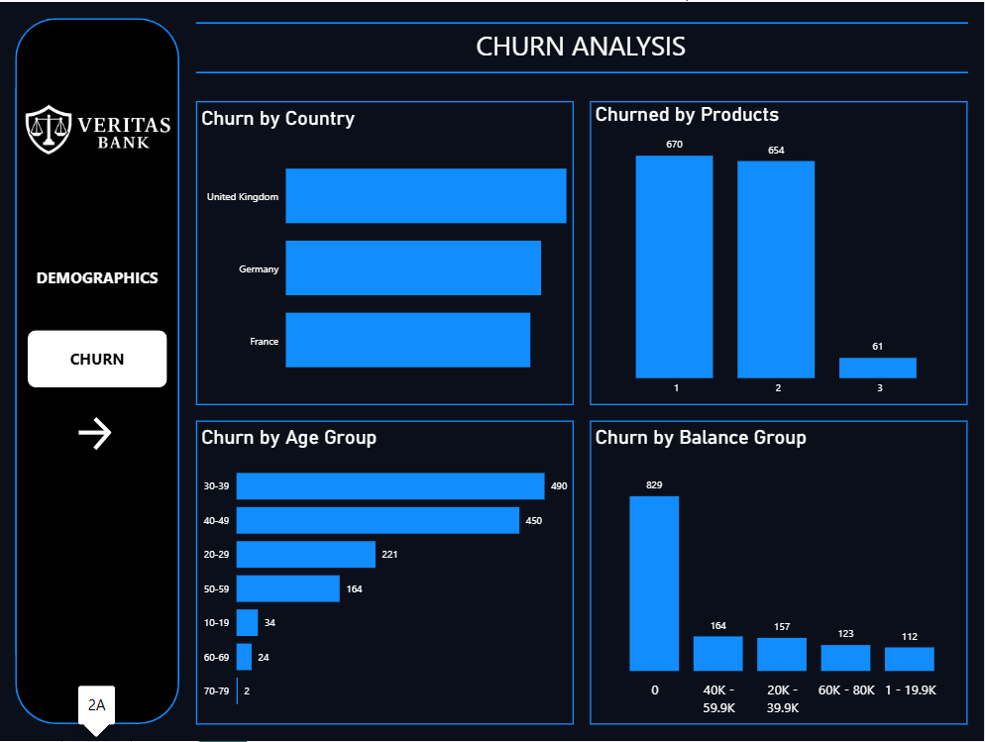
Dashboard — Churn Analysis Overview
Page 2A: churn filtered by country, product holding, age group and account balance.
1,385
Customers Churned
£0 Balance
Largest single churn segment (829 customers)
30–39 yrs
Highest-churn age group (490 customers)
Customers holding 1–2 products account for 95% of all churn — almost matching their share of the customer base, so product count alone is a weak predictor of churn here.
UK
Highest churn in absolute terms, roughly in line with its larger customer share
Veritas Bank | Customer Churn & Retention Analysis
7

Slide 7
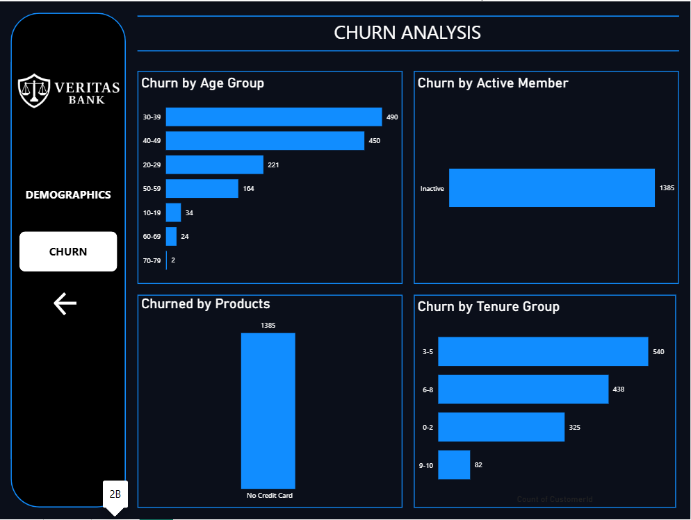
Dashboard — Churn Deep Dive
Page 2B: churn filtered by active-member status and customer tenure.
100%
Of churned customers were inactive members
71%
Of churn happens in years 3–8 of tenure (540 + 438 customers)
Only 6%
Of churn comes from 9–10-year customers — the most loyal group
Inactivity is the single strongest churn signal in this dataset — every churned customer had gone inactive first.
68%
Of churned customers are aged 30–49
Veritas Bank | Customer Churn & Retention Analysis
8

Slide 8
Key Insights
What the data tells us about why Veritas Bank customers leave.
1
Inactivity drives churn
Every single churned customer was flagged inactive — the clearest early-warning signal available.
2
Zero-balance accounts are highest-risk
829 of 1,385 churned customers (60%) held a £0 balance at the time they left.
3
The mid-tenure window is critical
71% of churn happens between years 3 and 8; customers who reach year 9+ rarely leave.
4
Core age group most exposed
Customers aged 30–49 make up 68% of all churn, despite being the bank's biggest segment.
5
Country churn tracks customer share
UK, Germany and France churn roughly in proportion to their customer base — no single market is a standout outlier.
Veritas Bank | Customer Churn & Retention Analysis
9

Slide 9
Recommendations
Thank you
Practical, data-driven actions to reduce churn and strengthen retention.
1
Launch proactive re-engagement campaigns that flag members as soon as they go inactive — before dormancy turns into churn.
2
Target £0-balance accounts with incentives such as fee waivers or savings promotions to rebuild engagement.
3
Focus loyalty rewards on customers in years 3–8 of tenure, the critical window where most churn occurs.
4
Build retention offers around the 30–49 age segment — e.g. mortgage, investment, and family-banking bundles.
5
Roll out the real-time Power BI churn dashboard bank-wide so account teams in all three markets can act early.
Conclusion: Churn at Veritas Bank is driven less by geography or product count, and more by engagement — inactivity, low balances, and the mid-tenure relationship window. Targeted, proactive retention here offers the clearest path to reducing attrition.

